Slide 1
Lighthouse Labs DS
PROJECT:03
Data Visualisation and Dashboards with Tableau
By Jamie Dormaar. Dec 12th, 2022

Slide 2
OPTION 2: CAUSE OF DEATH – OUR WORLD IN DATA

Slide 3
THE PLANET’S SURVIVAL PLAN!!
Analyze global mortality, and by extension master it’s survival success patterns!

Slide 4

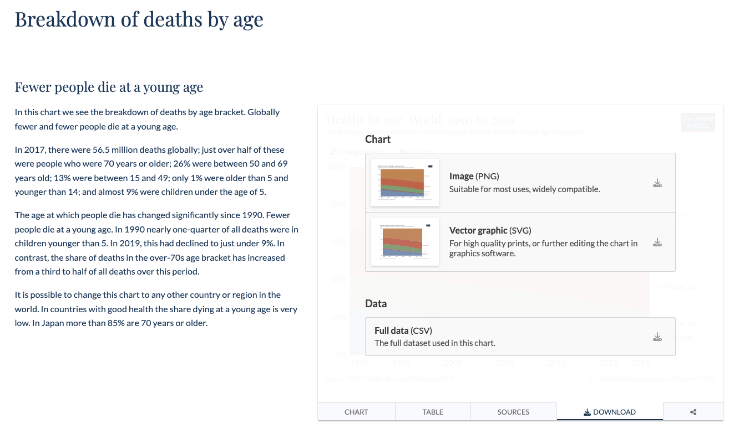
HOW ARE THE GLOBAL MORTALITIES DISTRIBUTED DIFFERENTLY AMONGST VARIOUS AGE GROUPS?
ETL
https://ourworldinndata.org

Slide 5
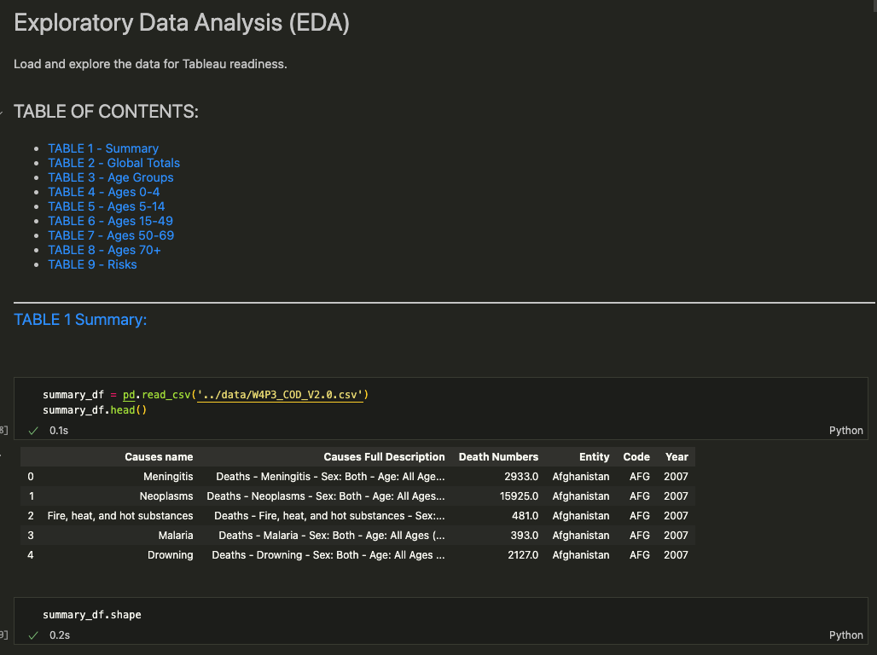
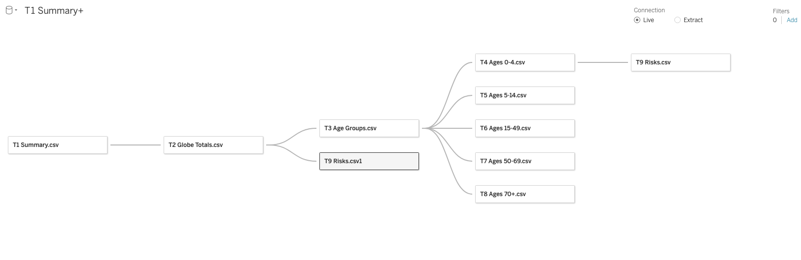
ETL
Pandas in python:
Explore & Transform
Yellow
Is the color of gold, butter and ripe lemons. In the spectrum of visible light, yellow is found between green and orange.
LOAD
Tables into Tableau:
Yellow
Is the color of gold, butter and ripe lemons. In the spectrum of visible light, yellow is found between green and orange.
Blue
Is the colour of the clear sky and the deep sea. It is located between violet and green on the optical spectrum.

Slide 6
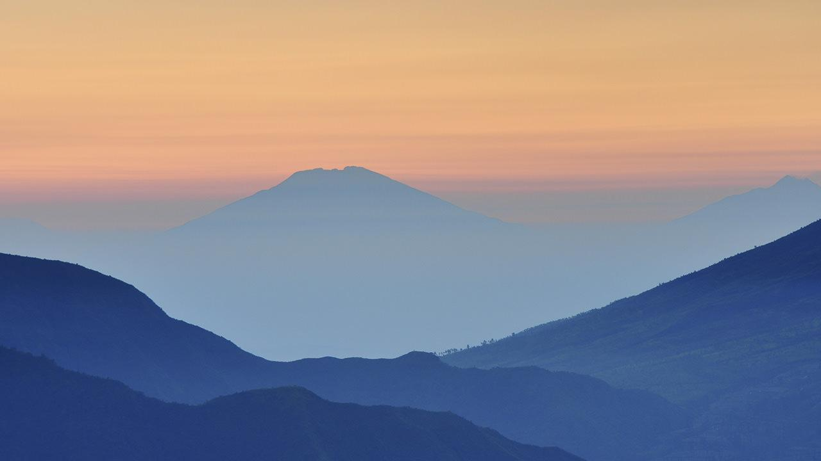
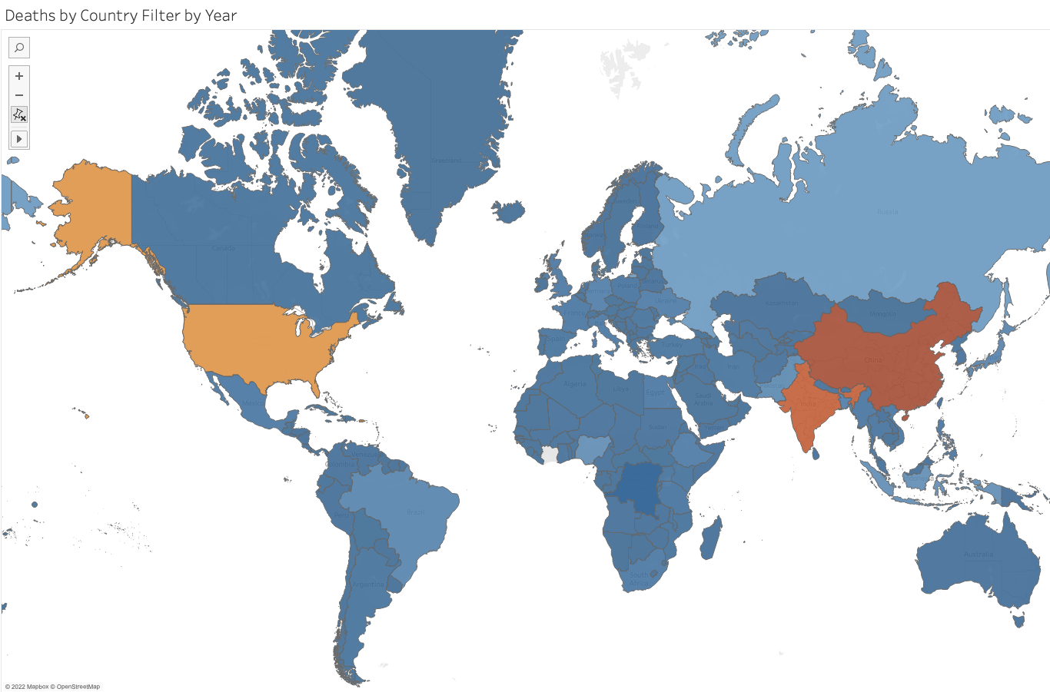
World map, with country and causes of death interactivity

Slide 7
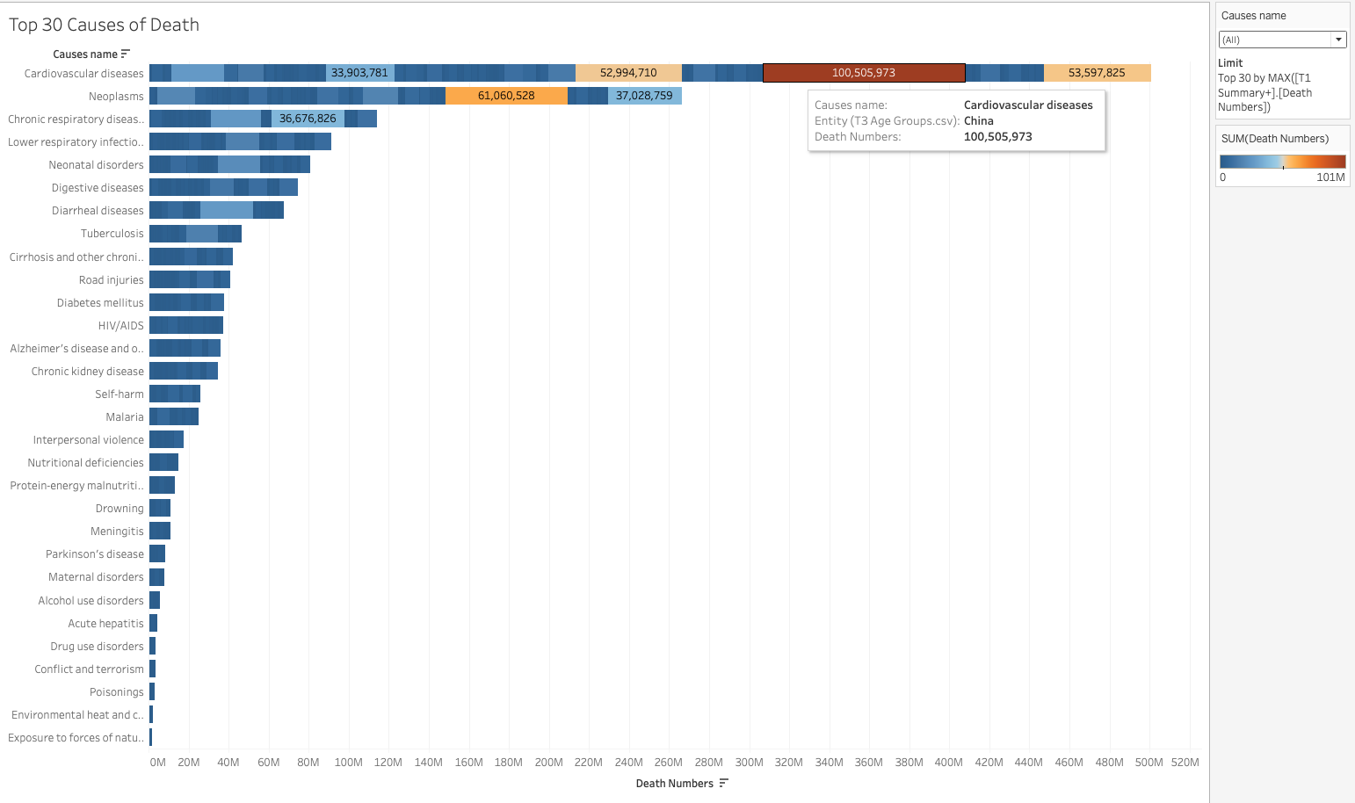
Stacked Bar Chart, filtering for the top 30 causes

Slide 8
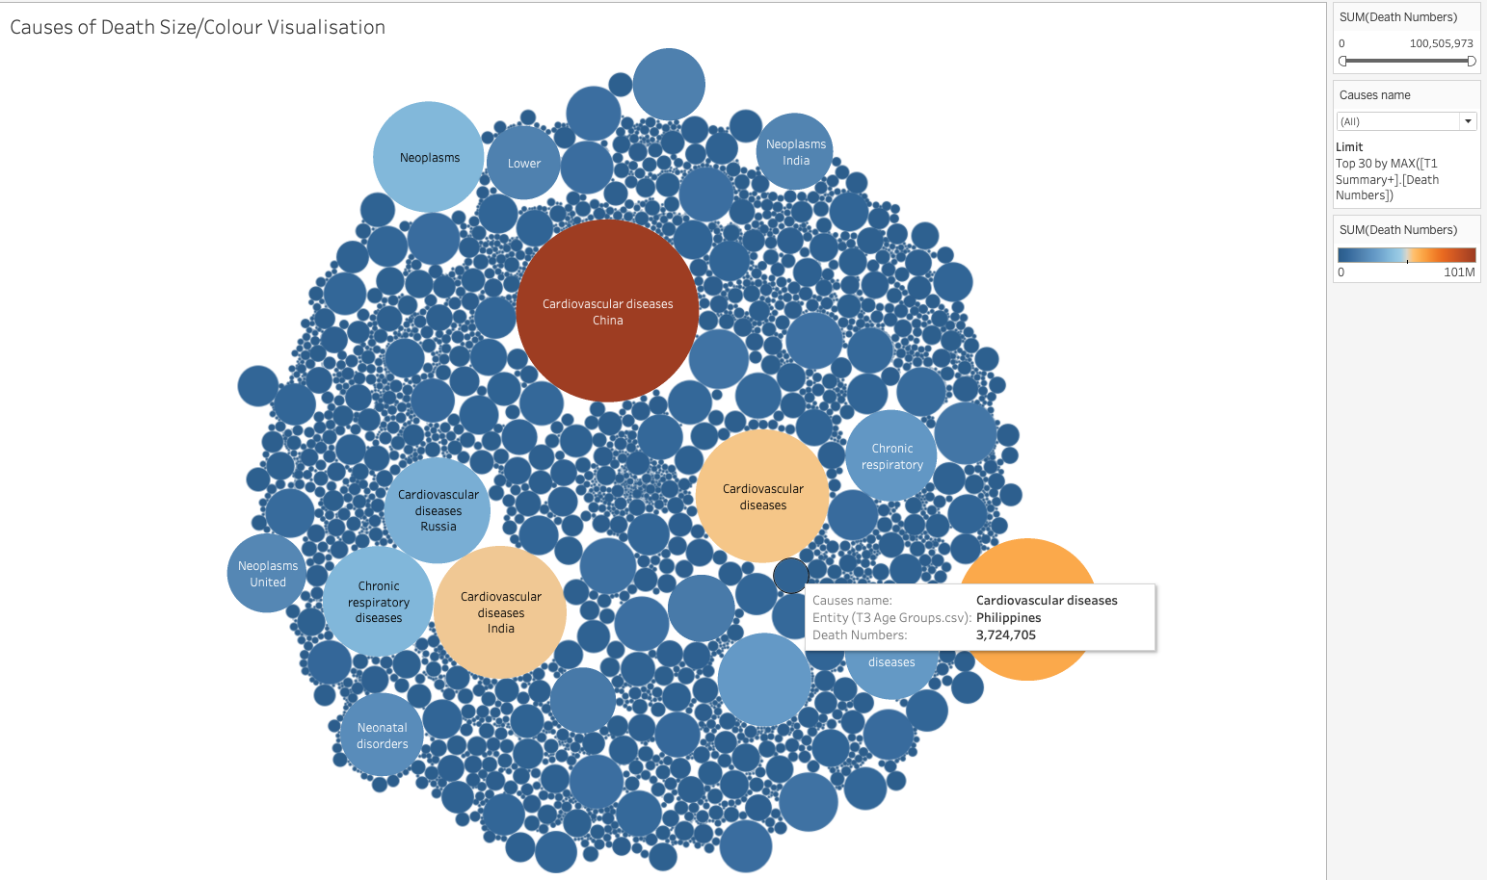
Stacked Bar Chart, filtering for the top 30 causes

Slide 9
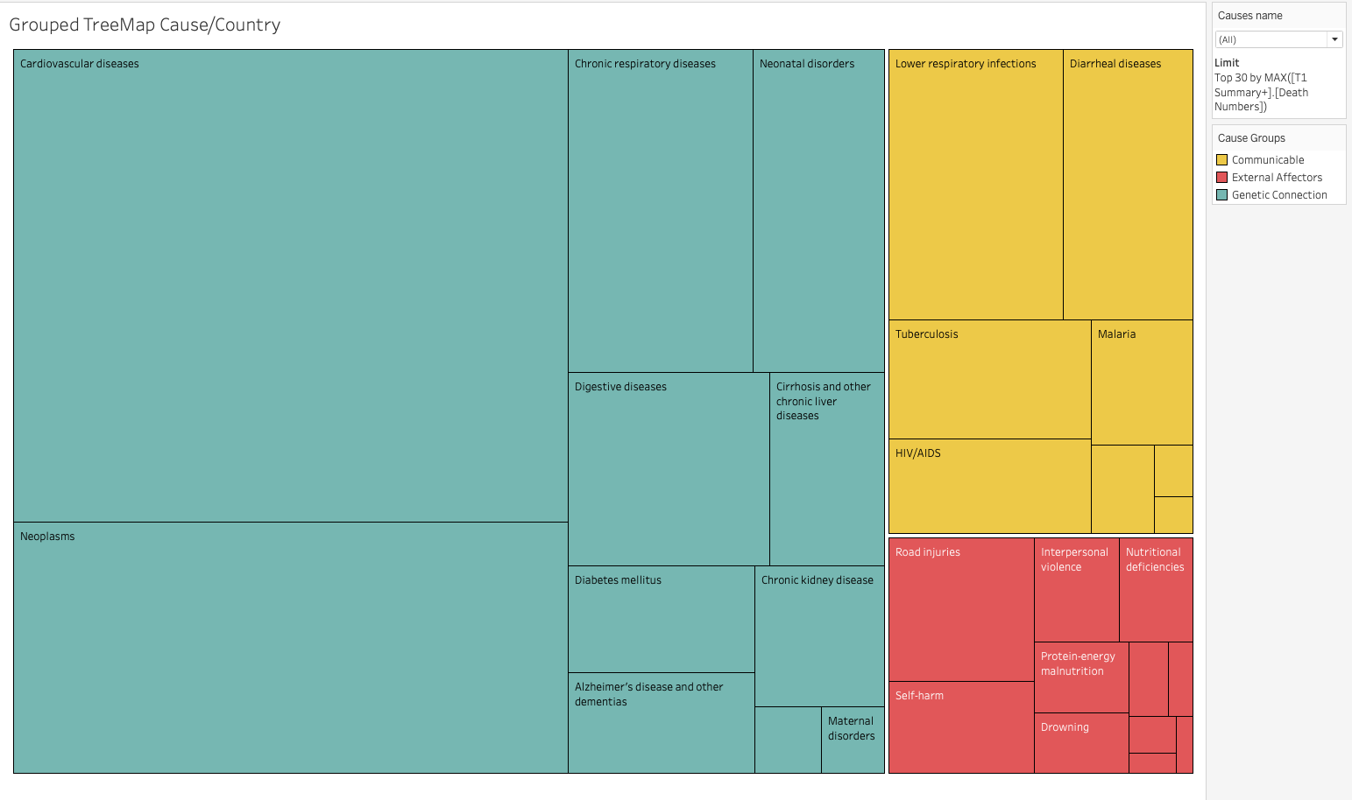
TreeMap: Also filtering for the top 30 causes
Communicable:
Areas of research with
Connections to genetic/genomic heritability
External
Affectors

Slide 10
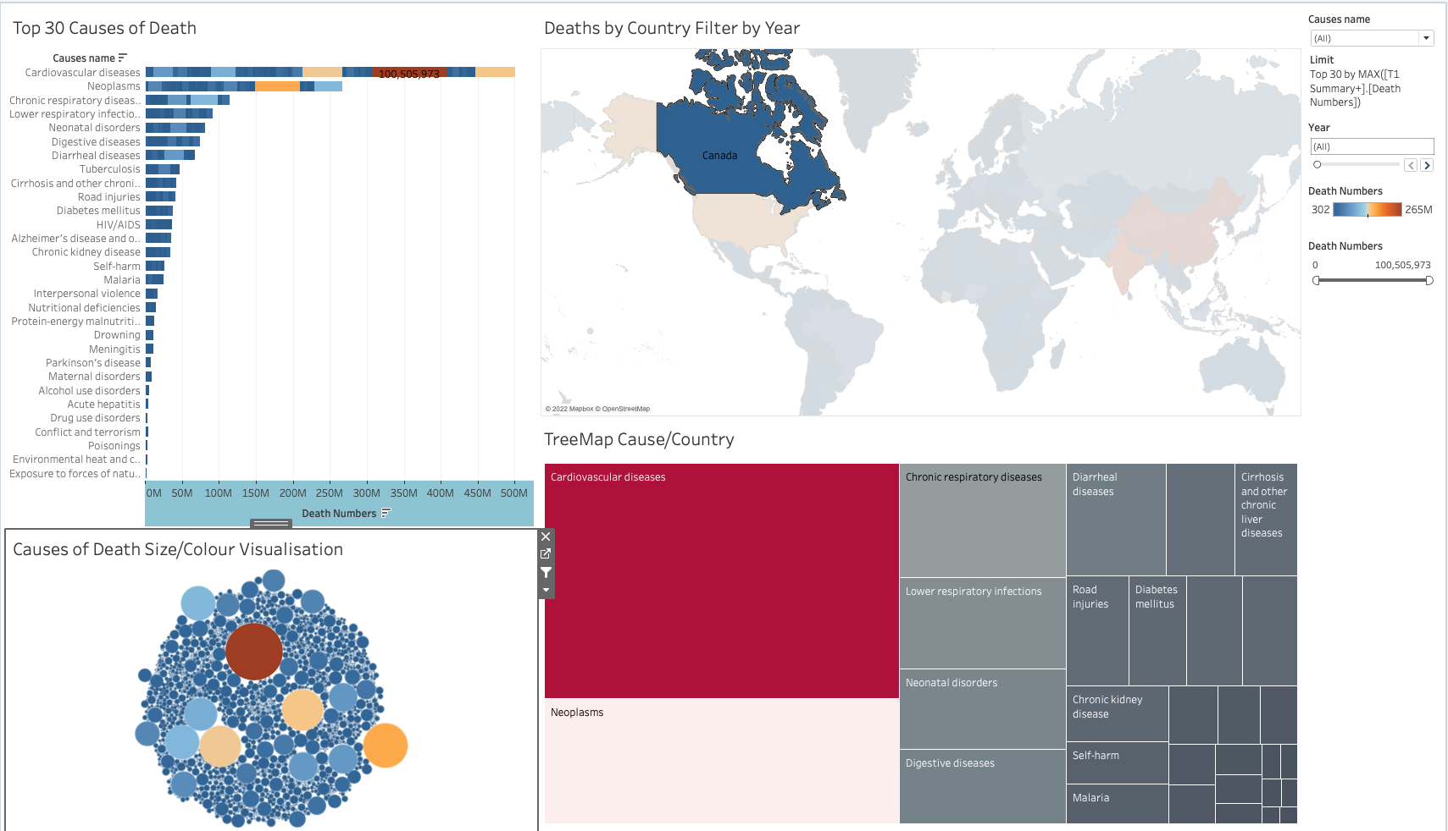
TreeMap: Also filtering for the top 30 causes

Slide 11
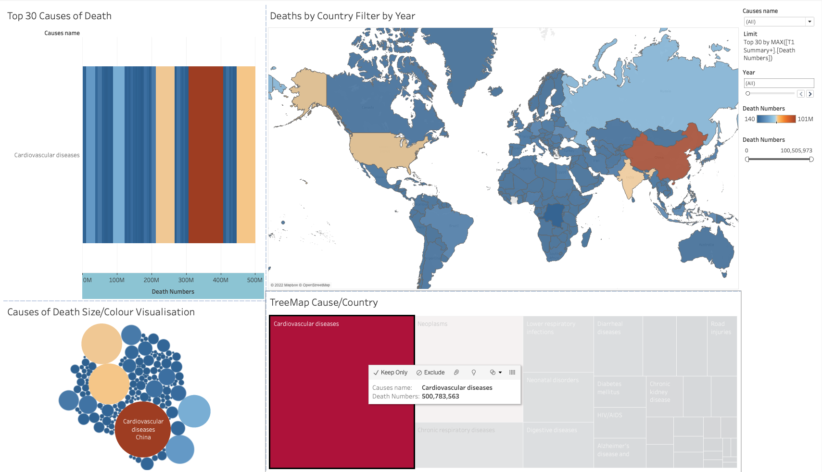
TreeMap: Also filtering for the top 30 causes

Slide 12
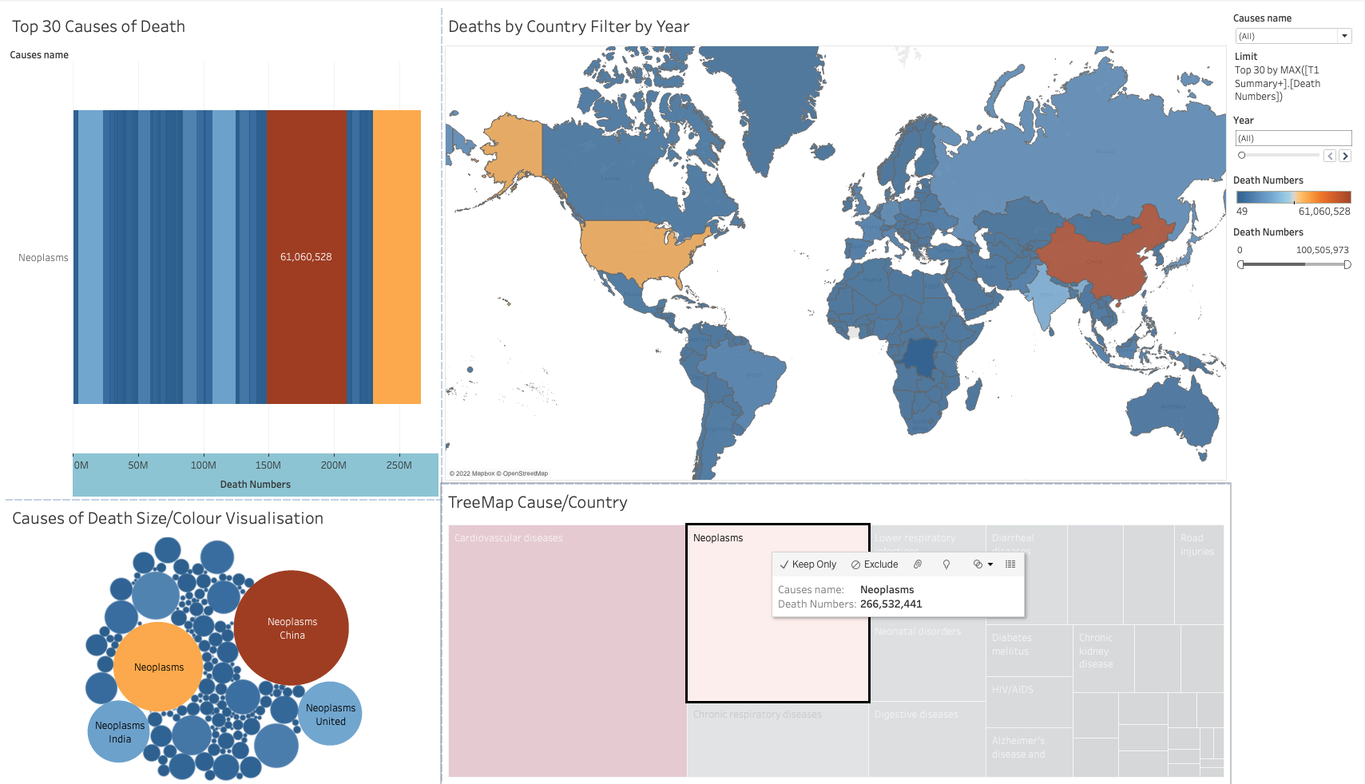
TreeMap: Also filtering for the top 30 causes

Slide 13
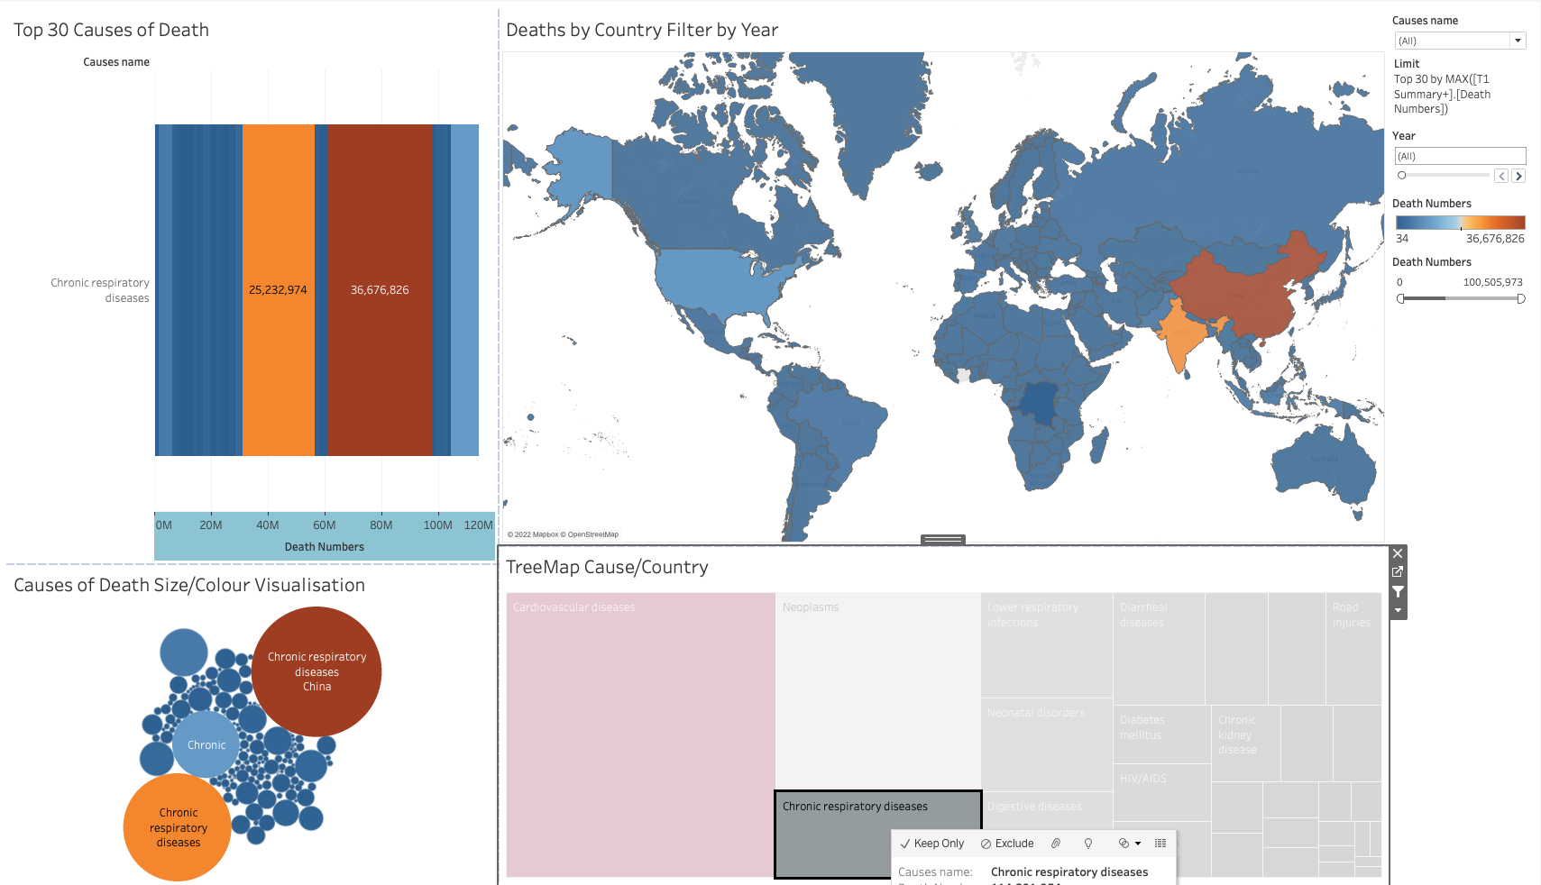
TreeMap: Also filtering for the top 30 causes

Slide 14
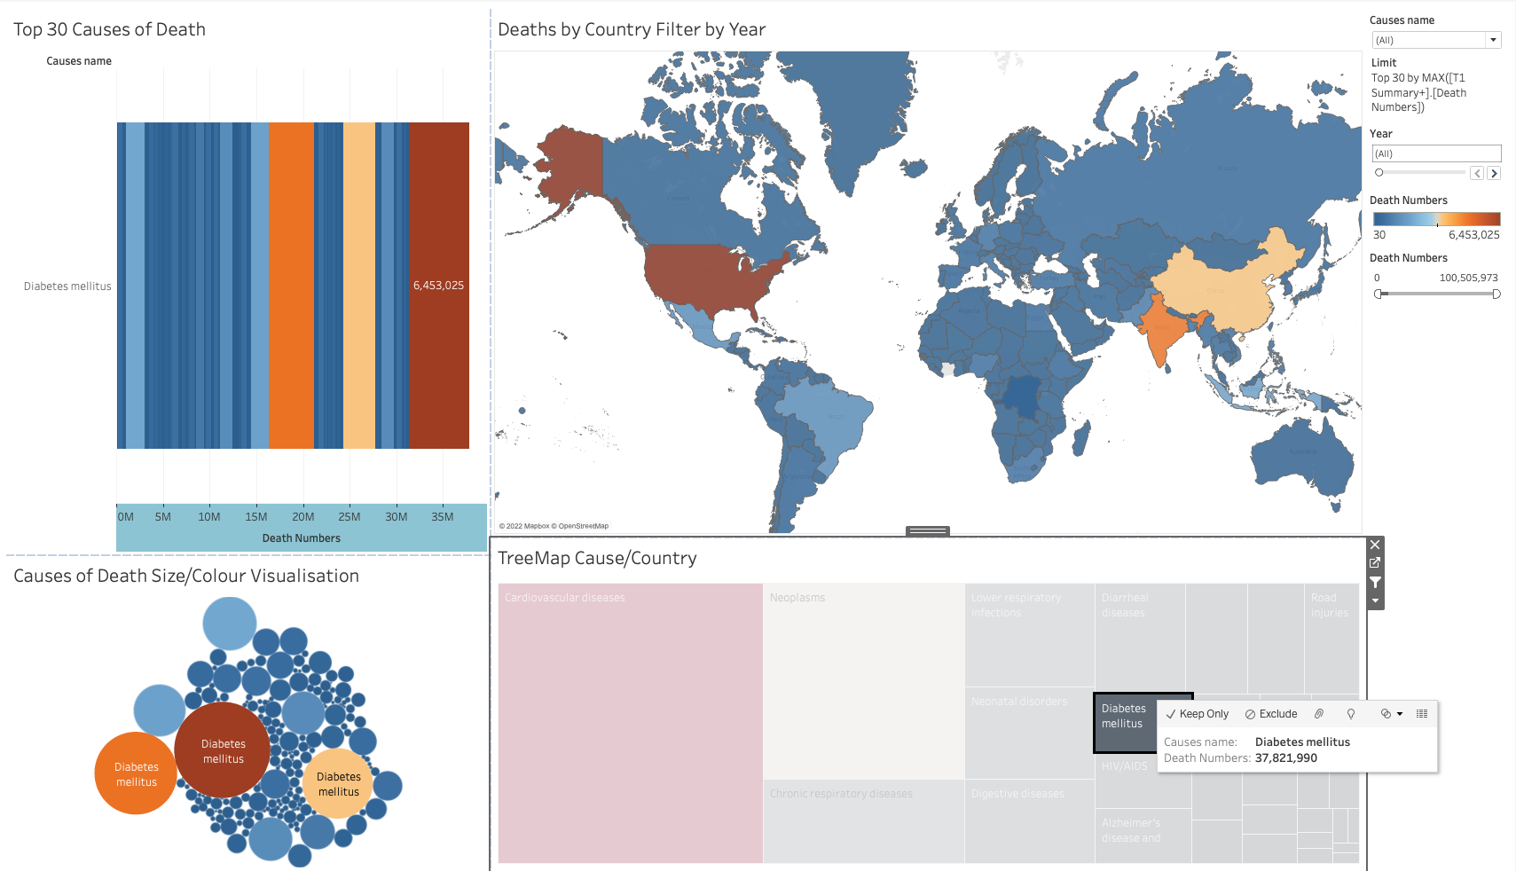
TreeMap: Also filtering for the top 30 causes

Slide 15
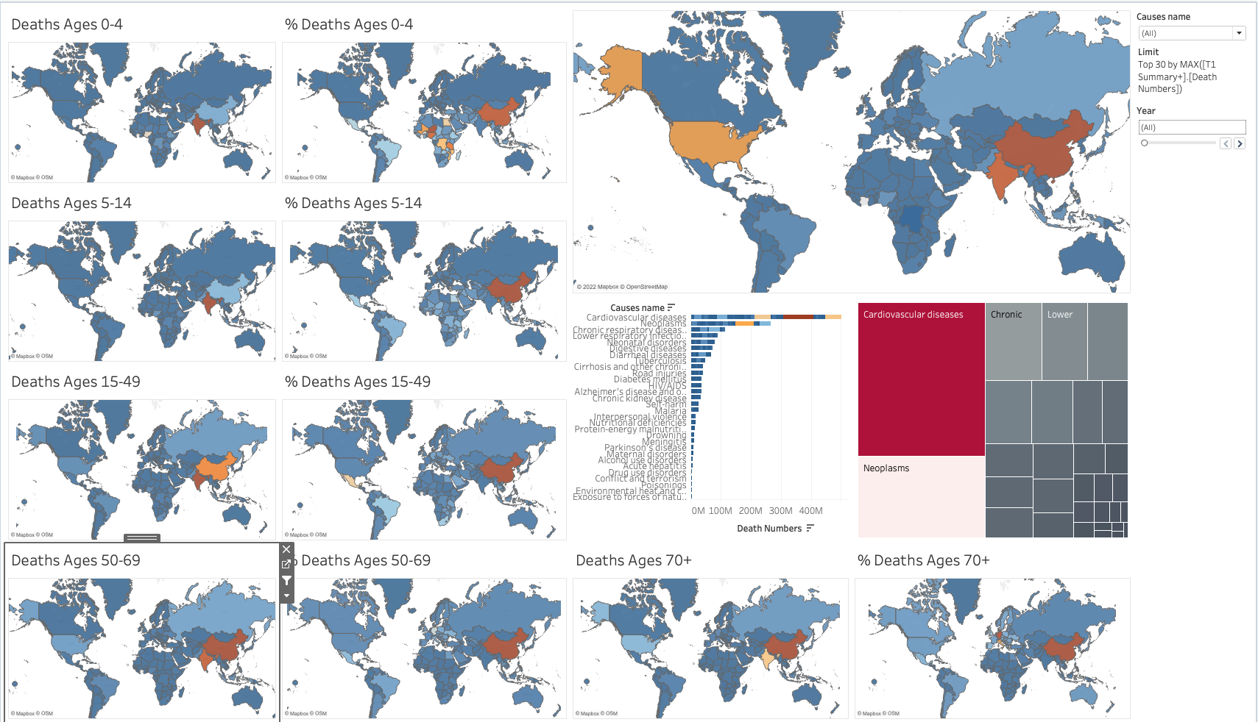
TreeMap: Also filtering for the top 30 causes

Slide 16
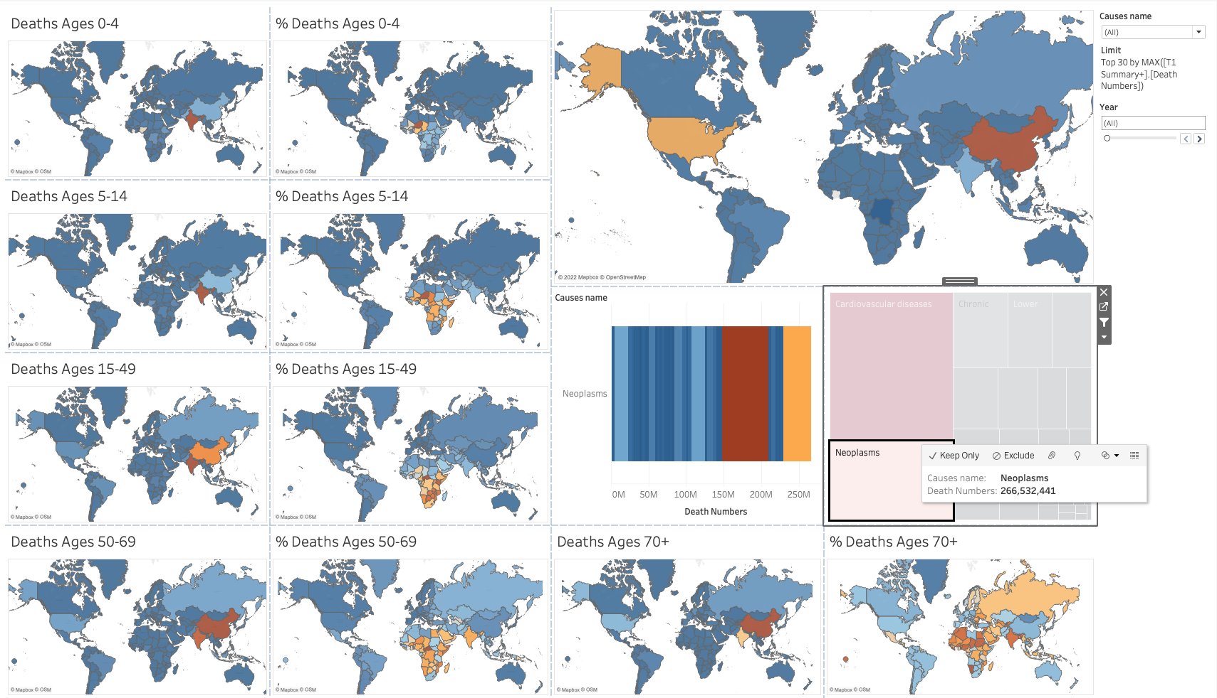
Cancer tends to impact the elderly

Slide 17
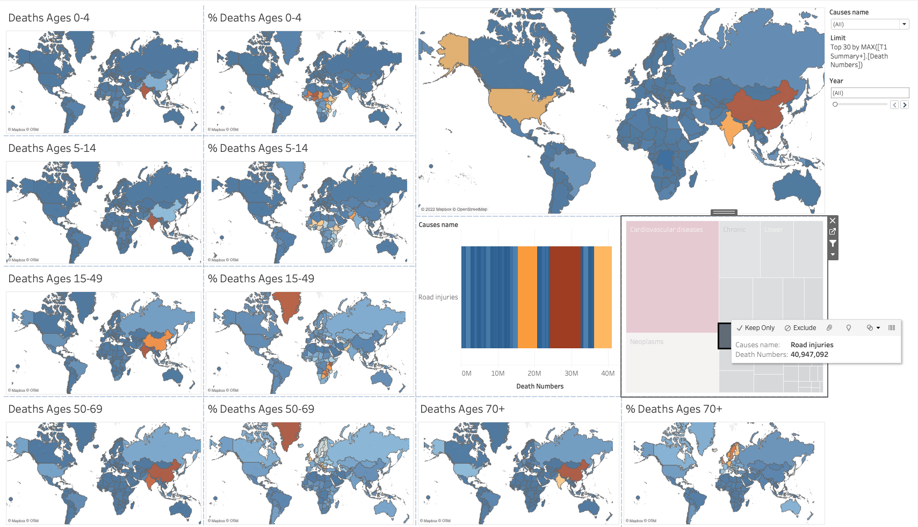
Road Injuries in Greenland! Who knew!!?

Slide 18
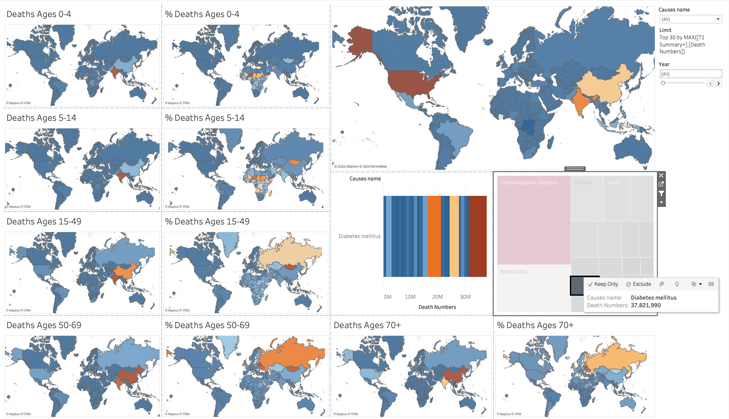
Diabetes in Russia.

Slide 19
Diabetes in Russia. Superior survival in the other areas of potential deathy-ness, or do they craft masterful sweets worth getting diabetes for?

Slide 20
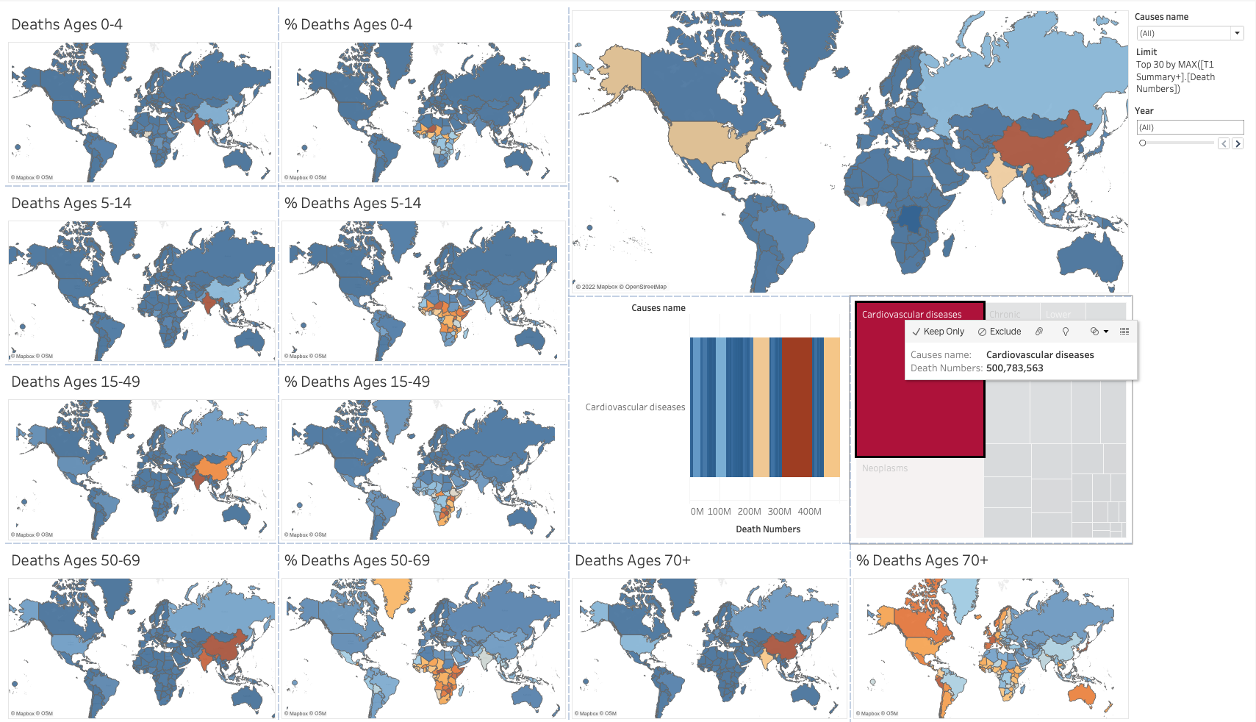
TreeMap: Also filtering for the top 30 causes
Cardiovascular diseases:
A surprising story

Slide 21
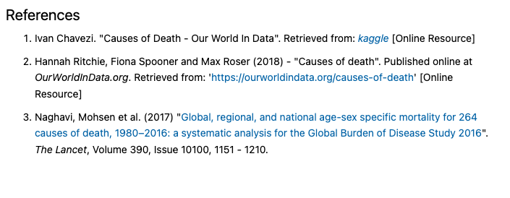

Slide 22
THANKS!
Any questions?
jdormaar@gmail.com

